Slide 1
Instructional Design Center
Updating Contact Information

Slide 2
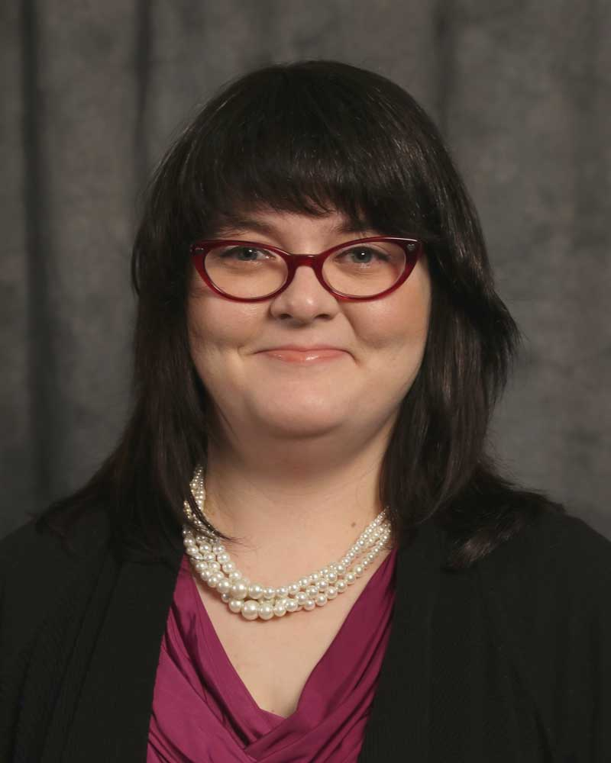
Megan Jones Instructional Designer

Slide 3
What are Contacts?
Blackboard uses a tool called Contacts to manage contact information for instructors and facilitators in online or hybrid/blended courses.

Slide 4
Why use Contacts?
While it is possible to create your own contact information by editing a course item, Blackboard can simplify that process by providing a pre-determined format to display your contact information.
Contacts can then be linked in the Course Menu for easy access.
Adding course menu links is covered in another tutorial.

Slide 5
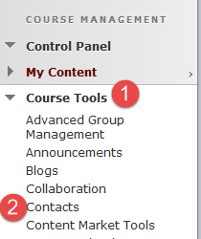
Updating Your Contact Information
We will begin by logging in to Blackboard and entering a course.
From there, let’s take a look at the Contacts (2) tool, which is located in the Course Tools group (1) under the Course Management menu.

Slide 6
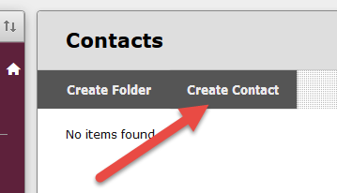
Updating Your Contact Information
After clicking the Contacts tool, you will be taken to the Contacts area.
This is where we will create contact information for you.
The next step will guide you to click the Create Contact button at the top of the page

Slide 7
Updating Your Contact Information
Once you click on the Create Contact button, you will see a new page appear, called Create Contact.
For this example, let’s put in my information…

Slide 8
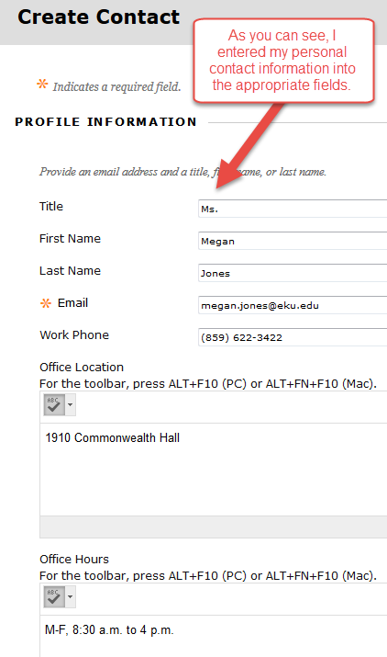
Enter your contact information

Slide 9
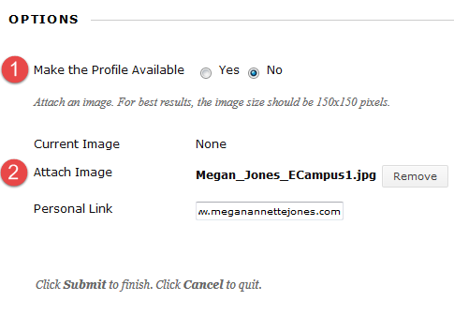
Updating Your Contact Information
You can also add a picture (2) and make sure the contact information is available for the student to see (1).
Remember, you photo is optimally viewed if it is 150 pixels tall and 150 pixels wide.

Slide 10
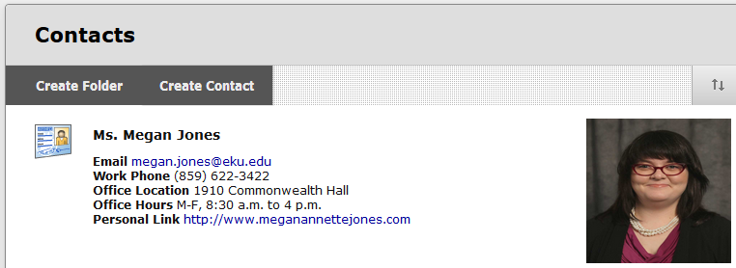
Updating Your Contact Information
After making your changes and adding a photo, click Submit. Blackboard will allow you to view your changes:

Slide 11
Instructional Design Center
Thank You!
If you need help or support, please do not hesitate to contact me. I can be reached at megan.jones@eku.edu and (859) 622-3422.

