Slide 1
Instructional Design Center
Adding a File to a Course

Slide 2
Megan Jones Instructional Designer

Slide 3
Types of Files
Blackboard supports several file types. A list of them can be found at Blackboard’s library site. For quick reference, here are some common types of files you can upload:
Microsoft Office files – DOC, DOCX, XLS, PPT
Image files – JPEG, JPG, GIF, TIFF
Video files – AVI, MPG, MPEG, MOV
Text/Document files – PDF, HTML, TXT

Slide 4
Adding Files
Knowing how to add files to a course gives you flexibility as an instructor.
There are two places where you can attach files:
Content attachments: This type of upload creates a separate content item within a Blackboard course page.
Text editor attachments: This type of upload is used when you are linking to files from within the Blackboard text editor.

Slide 5
Content Attachments
The first step to adding a content attachment is to navigate to where you would like to display your file.
For this example, I’m going to add a content attachment to my Module 1 page within Blackboard.
I navigated to the Module 1 page and then clicked on the menu item Build Content, which is located below the title.

Slide 6
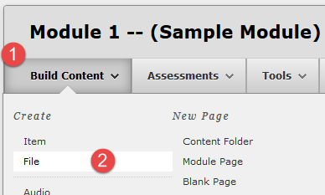
Content Attachments
Select the File link. You can see where you are within the course by viewing the breadcrumb links below the main Blackboard menu.

Slide 7
Content Attachments
After you have clicked on File, you should see the Create File page load.
There are a few options to consider, so let’s look at the items beneath the Select File heading first.
This area is where you will actually upload the file.
Before we begin, let’s take a look at the three options we have when uploading files to Blackboard.

Slide 8
Three Ways to Upload Files
Browse My Computer: This allows you to select a file from your computer to upload.
Browse Content Collection: This option allows you to select a file from your Content Collection.
Inserting a Hyperlink within Text: This option is only available in items with text included, which will be covered later in this lesson.

Slide 9
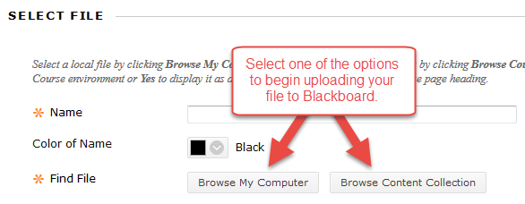
Content Attachments
Once you decide which option you want to choose, click the corresponding button.

Slide 10
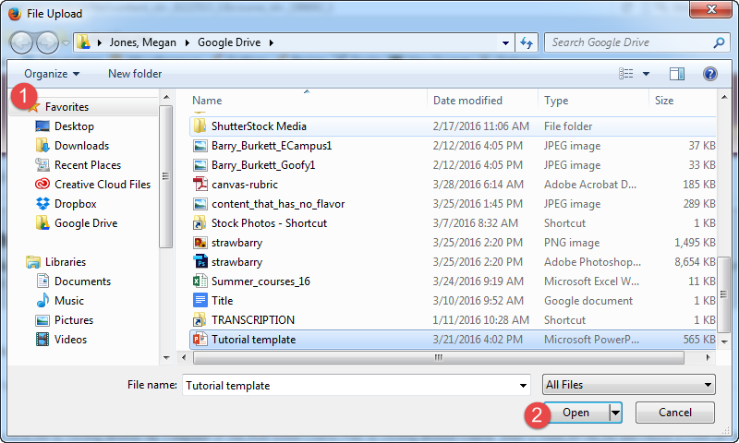
Content Attachments
For this example, I am going to upload a local file to Blackboard by choosing Browse My Computer.
After selecting this option, you should see a File Upload window pop up.
This is where you will choose the file you want to upload.

Slide 11
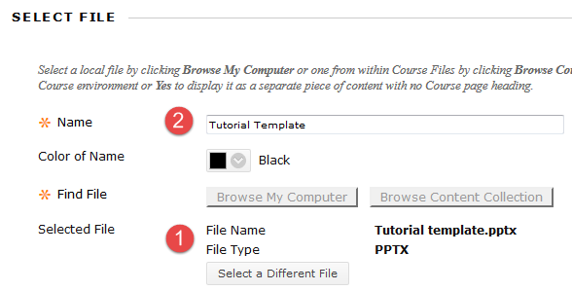
Content Attachments
Upon clicking Open, Blackboard will show the file name and type by the Selected File item.
Create a name for your file.
You may also choose to Select a Different File if you accidentally uploaded the wrong one.

Slide 12
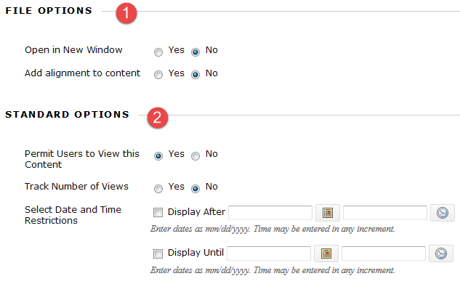
Content Attachments
Next, we will look at the options beneath the File Options and Standard Options sections.
Under File Options, you can select the option to have the file open in a new window (which is recommended)
You can control access to the file as well as setting when the item is available.

Slide 13
Content Attachments
After clicking Submit, you will be taken back to the original page (in my case, the Module 1 page).
You should see your file as the last option on the page.
You may re-order contents by clicking and dragging individual items or using the up/down button to re-arrange items en masse.

Slide 14
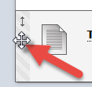
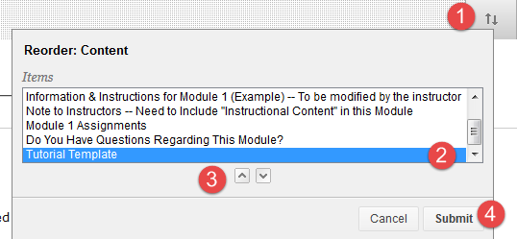
Rearranging Course Items
There are two ways to re-arrange course items within a Blackboard course page.
The first way is to click and drag individual items up and down the page to create the order you want.
The second way to re-order content is to click the up/down button in the upper, right-hand corner of the course page.

Slide 15
Rearranging Course Items
A small window should pop up, showing all of the content items on that page.
Click the item you want to move, and press the up/down buttons to re-order the item.
Click Submit to save your changes.
Click the up/down button (1) and then select the item you want to move (2). Click the up/down buttons (3) to move the item to your desired location on the page. Click Submit (4) to save your changes.

Slide 16
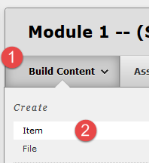
Text Editor Attachments
The next way to add attachments to your course involves the text editor screen.
This will allow you to add a text description or more information to an attached file.
To begin, find the location where you would like to upload your file. In this case, I’ll use the Module 1 page again.
Click Build Content and then click Item.
Click Build Content (1) and then Click Item (2)

Slide 17
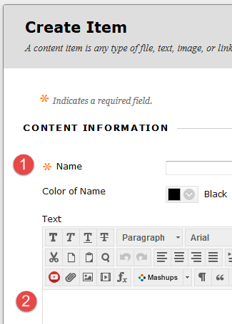
Text Editor Attachments
Once you click Item, a new page called Create Item should load.
There are three sections you must customize: Content Information, Attachments, and Standard Options.
Enter a custom title and description of the file you are going to upload.
You can also upload multiple files.
Create a custom title (1) and description of the item (2)

Slide 18
Text Editor Attachments
The next step is to take a look at the Attachments section and upload a file.
It is the same process we used when we uploaded a file as a Content Attachment.
As before, I will click the Browse My Computer button to upload a local file on my computer.

Slide 19
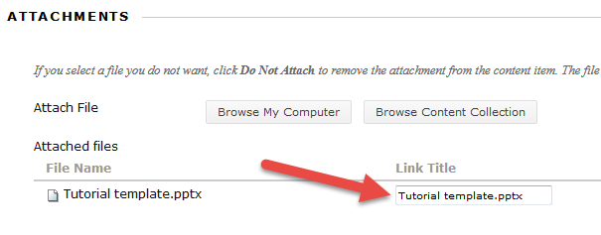
Text Editor Attachments
After clicking Open, you should see the file and its title on the Create Item page.
If you uploaded the incorrect file, you can click Do not attach to remove the file.
Verify you have the right file attached, and customize the link’s title if desired

Slide 20
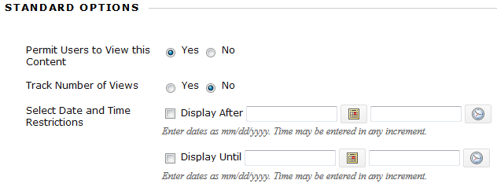
Text Editor Attachments
Next, set up the options in the Standard Options area, which is exactly the same format as before.
You can permit users to view the item, track the number of views, or set availability dates for the item.
Click Submit after you are finished.
Standard Options

Slide 21
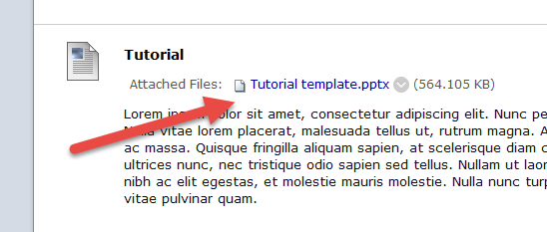
Text Editor Attachments
After clicking Submit, you should see the item at the bottom of the course page.
You may re-order the items as you wish by clicking and dragging or re-ordering them using the up/down button.
Content item with attachment and text

Slide 22
Inserting a Hyperlink
The third method of inserting files to your course is called hyperlinking.
You can create hyperlinks to files in the Content Collection, files from your computer, or files hosted on a Web server.
Remember, you can add a hyperlink within any text editor in Blackboard.

Slide 23
Inserting a Hyperlink
Let’s create a simple hyperlink that navigates the student to the Google search engine.
You’ll need to go through the same steps to obtain the Uniform Resource Locator (URL).
The first step is to open a Web browser and navigate to the Web page or document you would like to link.

Slide 24
Inserting a Hyperlink
Let’s create a hyperlink navigating the user to the Google search engine.
You’ll need to go through the same steps to obtain the Uniform Resource Locator (URL).
The first step is to open a Web browser and navigate to the Web page or document you would like to link.

Slide 25
Inserting a Hyperlink
The URL is located in the address bar of your Web browser (red box).
Copy the hyperlink by highlighting it with your mouse, right click, and select Copy.
Alternatively, you may also use the key combination CTRL and C to copy the text.

Slide 26
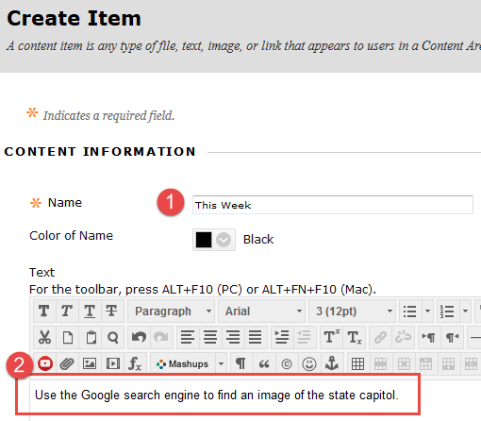
Inserting a Hyperlink
The next step is to create an item in Blackboard, as we did earlier with this tutorial.
Type in a custom title (1) and text (2).

Slide 27
Inserting a Hyperlink
Highlight the text you want to link with your mouse.
Click the hyperlink button in the Blackboard text editor.

Slide 28
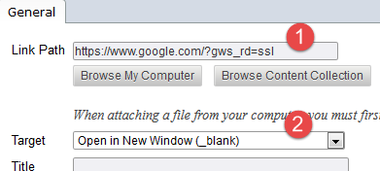
Inserting a Hyperlink
After you click the hyperlink button, a new window will pop up. It will ask for the Link Path and Target.
The Link Path box is where you will paste the URL you obtained earlier from your browser’s address bar (1).
Make sure the Target drop-down menu has Open in New Window selected (2).

Slide 29
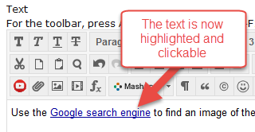
Inserting a Hyperlink
Once you click Insert, you should see the text you selected earlier highlighted in blue.
That text is now a hyperlink that navigates to http://www.google.com.
When a student clicks on the hyperlink, they will be instantly taken to the Web site. Click Submit to save your changes.

Slide 30
Instructional Design Center
Thank You!
If you need help or support, please do not hesitate to contact me. I can be reached at megan.jones@eku.edu and (859) 622-3422.

