Slide 1
Instructional Design Center
Adding Course Menu Items
Organizing Your Course

Slide 2
Megan Jones Instructional Designer

Slide 3
What are Course Menu Items?
Course menu items are menu links that point to specific areas of the course.
They can also link to Blackboard tools:
Groups
Discussion boards
Email
Menu items are versatile in nature and can be customized.

Slide 4
Types of Course Menu Items
Content Area: points to a blank page
Module Page: points to a blank module page
Blank Page: points to a customizable page. This page cannot contain course items
Tool Link: Links to any Blackboard tool

Slide 5
Types of Course Menu Items, Continued
Web Link: This course item functions as a hyperlink
Course Link: A Course Link item can point students to virtually any location in the course
Subheader: It is useful to classify links in the course by using subheaders.
Divider: This option allows you to insert a divider line

Slide 6
Creating Course Menu Items
In this tutorial, I will show you how to create three course menu items – the “big three”:
Content Area
Tool Link
Course Link
Each one of these course items functions differently. Let’s break down the big three!

Slide 7
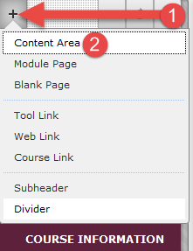
Adding a Content Area
Once you are in your course, please take a look at the left menu carefully. You should see a plus button in the top left corner of the menu.
Click this button to see the options to add a course menu item (1)
Click Content Area (2)z

Slide 8
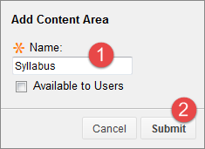
Adding a Content Area
After clicking on Content Area, a small window will pop up.
This window will ask for some basic information from you – in this case, the name of your Content Area is needed.
Let’s type in Syllabus (1) and click Submit(2)

Slide 9
Organizing Menu Items
You should see the Syllabus Content Area link at the bottom of the menu.
You can re-order the items by clicking and dragging them to their appropriate positions (red circle)
Alternatively, you can also organize your menu en masse by clicking the up/down arrows button at the top of the left course menu.

Slide 10
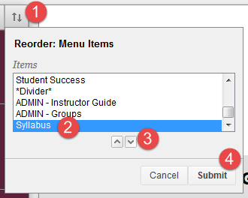
Organizing Menu Items, Continued
Click the up/down arrows (1) and select the item you want to move (2). Use the arrows at the bottom (3) to move the selected item up and down the menu. Click Submit (4) to confirm your changes.

Slide 11
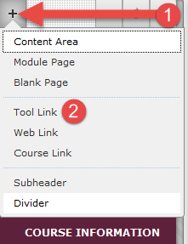
Adding a Tool Link
Once you are in your course, please take a look at the left menu carefully. You should see a plus button in the top left corner of the menu.
Click this button to see the options to add a course menu item (1)
Click Tool Link (2)

Slide 12
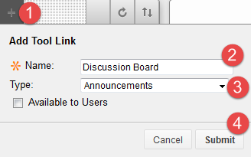
Adding a Tool Link
For this example, let’s create a custom tool link for a Discussion Board.
After clicking the plus button and selecting the Tool Link option (1), the Add Tool Link window will appear.
Type “Discussion Board” in the Name box (2) and choose Discussion Board from the drop-down menu (3).
Click Submit to save your changes (4)

Slide 13
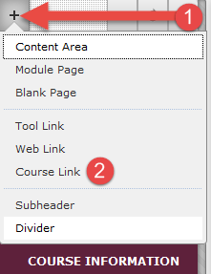
Adding a Course Link
Once you are in your course, please take a look at the left menu carefully. You should see a plus button in the top left corner of the menu.
Click this button to see the options to add a course menu item (1)
Click Course Link (2)

Slide 14
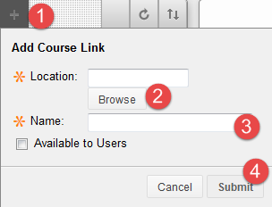
Adding a Course Link
After clicking on Course Link, a small window will pop up.
For this example, we will create a Course Link to take us directly to Module 1.
Under Location, click Browse (2).
You will see another window pop up that features all of the items in your course

Slide 15
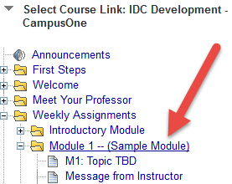
Adding a Course Link
Click Browse to find a specific item in your course that you want to link to (2).
You should see a window pop up that lists every item in the course.
Select your desired item, in this case we’re selecting Module 1.

Slide 16
Adding a Course Link
Click the plus button (1) and choose Course Link.
Click Browse to find a specific item in your course that you want to link to (2).
Then, create a custom name for the link in the Name area (3).
Save your changes by clicking Submit (4).

Slide 17
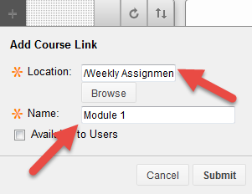
Adding a Course Link
After selecting a course item, Blackboard will populate the Location and Name areas of the window.
Click Submit to save your changes.

Slide 18
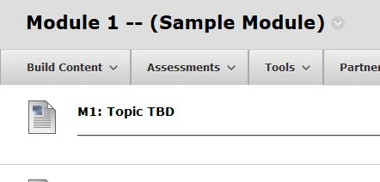
Adding a Course Link
Once you click Submit, a Course Link for Module 1 will be placed at the bottom of the course menu.
If we click on the Module 1 Course Link, it will take us directly to the Module 1 page

Slide 19
Instructional Design Center
Thank You!
If you need help or support, please do not hesitate to contact us. We look forward to helping you!

